Slide 1

AWG EMAIL ANALYTICS:
Email Effectiveness When Changing Cadence
Email Effectiveness While Changing Cadence
Team Members: Fan Yang, Gege Yao, Medha Bhat, Zhu Tao, Jiaxuan Yan, Sicong Li, Chenyang Zhao

Slide 2
Agenda
1
About AWG
4
Data Overview
2
Introduction
5
Results and Takeaways
3
Business Problem and Solution
6
Recommendations

Slide 3
About AWG Inc
3400 locations
1100 member companies
31 states
9 wholesale divisions

Slide 4
Introduction to Email Marketing
Objective
Approach
Advantages
Improve brand awareness
Enhance customer retention
Targeted messages via email
Direct customer Engagement
Cost-effective
Direct outreach
Notes:
Email marketing plays a key role in boosting brand awareness and improving customer retention through targeted messages and direct engagement. It is not only cost-effective but also ensures direct outreach to the audience.

Slide 5
BUSINESS PROBLEM & SOLUTION

Slide 6




Current Strategies
2023
Sent on a Biweekly Basis
2024
Sent on a Weekly Basis
Moving forward
?
Notes:
Looking at the current strategies, AWG started with a biweekly email schedule in 2023.
In 2024, this shifted to a weekly frequency to increase engagement.
Now, moving forward, AWG is exploring what cadence delivers the best results and maximizes audience response.

Slide 7
Objectives
Metrics
Key points of focus
Assessment of Email Marketing Performance
Comparison of 2 years’ emails
1
Conversion rate, engagement rates
1
2
Identify most engaged members
2
Open rates, clicks, views
3
Recommend optimum strategy
3
Analysis of Domains and Links

Slide 8
Data Overview
Data sources:
Our primary data sources are internal email performance data. Specifically, we have three sources of data:
2023-2024 Email Report (aggregated overall email performance metrics)
2023-2024 Domain summaries (engagement by email domain)
2023-2024 Link Summaries (engagement by URL link)

Slide 9
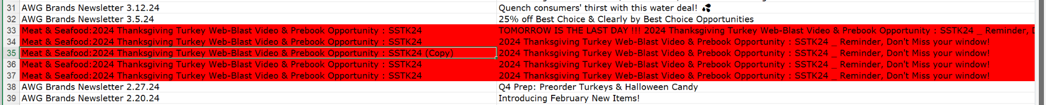
Preprocessing:
We merged all the weekly and bi-weekly files into some consolidated data file: Two file for link-level engagement (Links summaries), Two file for domain-level engagement (Domain summaries), and Two file for overall email performance metrics (Email Report Data).
Challenge
One challenge we faced was data uncertainty, including incorrect entries highlighted in red and
missing values we found during preprocessing step.

Slide 10
Methodology Followed
1
Data Cleaning & Integration
Merged email datasets from 2023 and 2024 (by domain and links)
Removed incorrect entries to ensure consistency and reliability.

Slide 11
Methodology Followed
2
KPI System Development
Focused on key email engagement indicators:
Total Views (%)
Unique Views (%)
Total Clicks (%)
Unique Clicks (%)
Click-to-View Ratio (Clicks-to-Views %)
Additional supporting metrics:
Bounce Rate
Unsubscribe Rate

Slide 12
Methodology Followed
3
Multidimensional Exploratory Data Analysis (EDA)
Year-over-Year Comparison:
Analyzed overall performance changes between 2023 and 2024 to identify trends.
Time Slot Analysis:
Examined engagement rate differences across various sending times (e.g., 9–10 a.m.) and different months.
Domain Analysis:
Identified domains with strong performance and those with significant attrition.
Link Analysis:
Filtered out top-performing and underperforming links based on click metrics.
Notes:
These explorations helped us confirm the impact factors and performance patterns across different dimensions.

Slide 13
Methodology Followed
4
Insight Extraction and Strategy Formulation
Based on findings across multiple dimensions, we propose a combination of strategies including optimized sending frequency, audience segmentation, and timing enhancements.
Notes:
Through this systematic analytical process, we were able to clearly identify the factors driving or hindering email engagement performance.
Next, My teammates will present some of our key findings.

Slide 14
RESULTS OF INTEREST

Slide 15
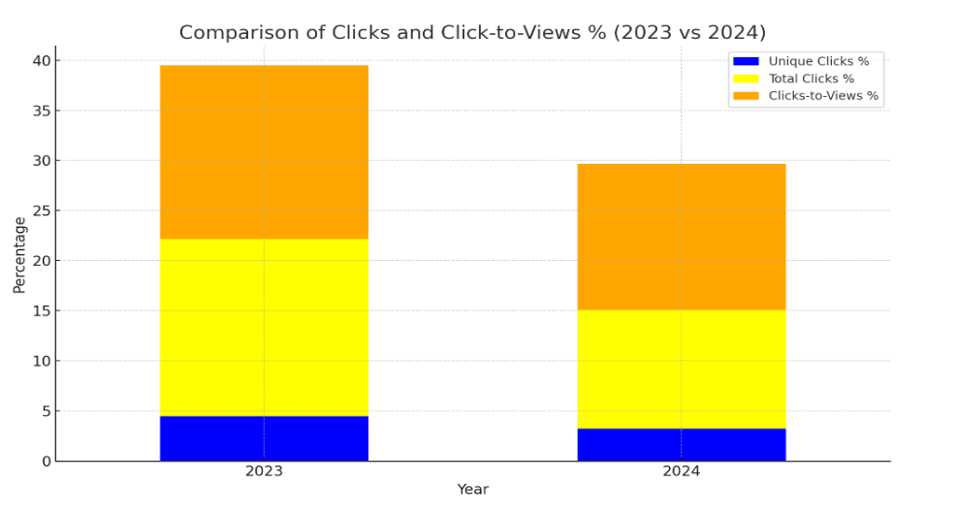
Results :
In 2024, both Unique Clicks % and Total Clicks % declined, along with a drop in Clicks-to-Views %, suggesting the email content was less engaging than in 2023.

Slide 16
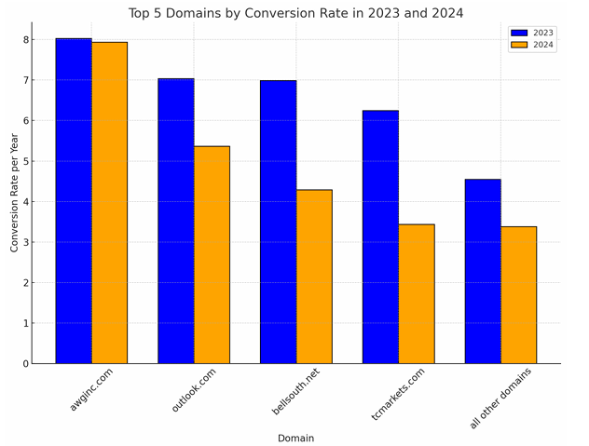
Results : Conversion Rate
Conversion rates ((Unique Clicks) / (Sent) *100) declined across all major domains in 2024, suggesting reduced campaign effectiveness or less motivated audiences.

Slide 17
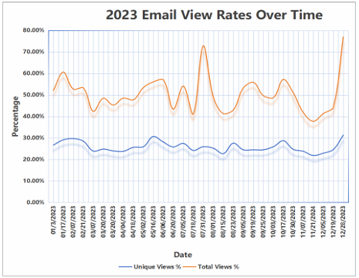
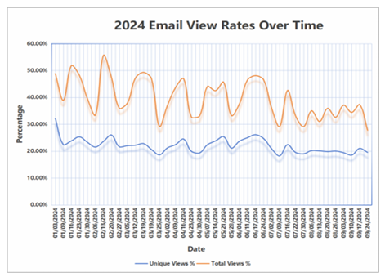
Results of Email View Rates
Email engagement declined in 2024, with a clear drop in both total and unique view rates compared to 2023, suggesting reduced audience interest or effectiveness of campaigns.

Slide 18
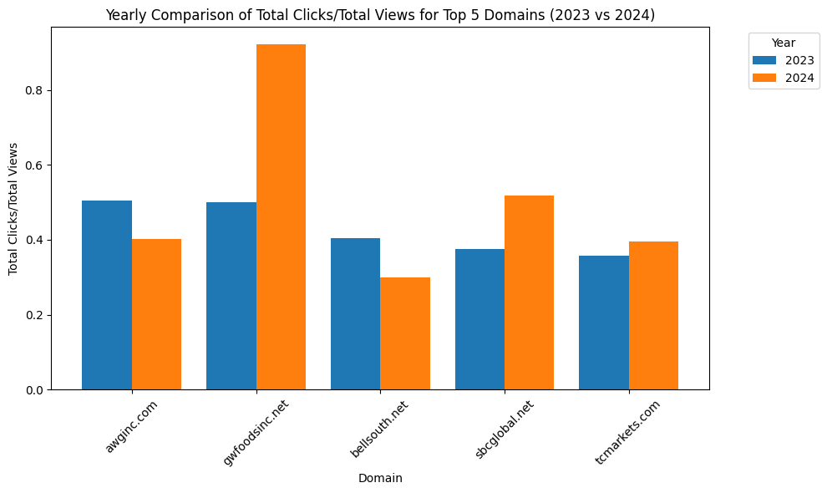
Results: Total Clicks / Total Views
Engagement improved for some domains, especially gywfoodsinc.net, while others saw declines, suggesting varied content effectiveness across domains.

Slide 19




Results: Domain Performance
2023: Peak total clicks, better performance
2024: Mixed results, weaker performance
awginc.com consistently led in both years
gwfoodsinc.net, greers.com, and foodgiant.com saw improvement
Notable drop in engagement for major
domains like outlook.com, dyerfoods.com, gmail.com.

Slide 20
Results: URL Analysis
URL Click Trends
2023 peak in total clicks occurred August–September, surpassing 2024’s January–March peak.
These peak periods reflect strong campaign timing and effective content delivery.
Top URL Performance
The top 2024 URL had fewer clicks than the top performer in 2023, indicating a decline in peak engagement.
Updates to content and relevance helped sustain or enhance visibility.
View Percentage Trends
View frequency and engagement dropped in 2024, suggesting a decline in user stickiness.
The Promotions Site continued to outperform others, reflecting strong interest and effective structure.

Slide 21
Takeaways: Challenges & Learnings
Team schedules were difficult to align.
This semester, everyone was busy and it wasn’t easy to work consistently. Although coordination was a challenge, we were able to finish everything.
Working as a team required clear communication.
Since different people handled data, visuals, and writing, we had to make sure everyone was aligned. Shared documents and regular updates helped keep things moving without confusion.
We learned how to respond to feedback and refine our approach.
As we progressed, we realized some early angles didn’t add much value. After reviewing feedbacks, we adjusted our report to provide clearer and more useful recommendations.

Slide 22
Takeaways: Challenges & Learnings
The project helped us better understand business impact.
Looking beyond open and click rates, we started to think more about what engagement trends mean for unsubscribe rates, and how email frequency can affect long-term customer retention.

Slide 23



Cadence Strategy Recommendation
Hybrid Cadence
Weekly emails during high-engagement periods (Aug/Dec),
Biweekly during lower-traffic months (April, May)
Segment Lists
High-performing domains receive regular weekly content
Lower-performing domains receive less frequent, personalized communications
Optimize Timing
Set email dispatch timing within the 9:00 AM to 10:00 AM window

Slide 24

Conclusion
Hybrid Approach
Balance visibility and engagement
Optimize timing and segment based on reception

Slide 25
Appendix
Metric | 2023 (Bi-weekly) | 2024 (Weekly)
Total Views % | 35 | 24
Unique Views % | 19 | 15
Total Clicks % | 13 | 6
Unique Clicks % | 3 | 2
Clicks-to-Views % | 16 | 15
Bounces % | 0.43 | 0.06
Unsubscribes % | 0.003 | 0.007

Slide 26
THANK YOU

